Slide 1

EDUPRIME CLONE USING MERN+FIREBASE
Done By:
1)N.Akhil – 19071A12C1
2)Md.Irshad Ahmad – 19071A12F3
3)Ch.Mohan – 19071A12F4
4)Venkata Sai Gaman – 17071A12H7

Slide 2

ABSTRACT
Our current project deals with maintenance of student’s attendance and semester details. It is maintained on a daily basis of their attendance. The staffs will be provided with the separate username & password to update student status like attendance.
The staff who are handling the course/subject will be responsible to mark the attendance and update the mid marks of the students.

Slide 3
Problem Statement
Designing and developing of an Automated Management System which manages the student’s and faculty data. Knowing student attendance , academic reports is also one of the problems to be resolved through automation.

Slide 4

Problem Definition
Knowing of student’s attendance and academic reports which is to be organized and presented in a concise manner. An Automated system is need to display data virtually and also can be accessed by users at once. Application of leave for faculty, holiday details are also available in this management system.

Slide 5
Methodology
The information is managed by using NO-SQL database – firebase , a Google developed backend application is used to display necessary data in the form of tables or result set. (Requirements – JavaScript , NodeJS, documentation)
The UI(User Interface) is designed and developed using ReactJS – a JavaScript framework developed by Facebook
Integration of these two methodologies is the key to build this automated system.

Slide 6
System Requirements
Windows XP, Windows 7 (32/64 bit) or higher
Minimum 4 GB RAM and higher
10 GB available space on the hard disk
At least one Internet Browser e.g. Chrome, Firefox, Microsoft Edge etc.
Node.js
Active internet connection minimum speed 512kbps and above.
At least one installed code Editor to test and debug your code e.g.

Slide 7
Proposed System with Architecture
Since there are lot of drawbacks in the current existing system we plan on improving the efficiency of existing model like faster data retrieval and use of better and modern technologies.
The project will have 2 parts :
1)Faculty
2)Student
Faculty will be able to update student attendance and exam marks while also option to apply for leave.
Students will be able to check their current courses, attendance and their marks.

Slide 8
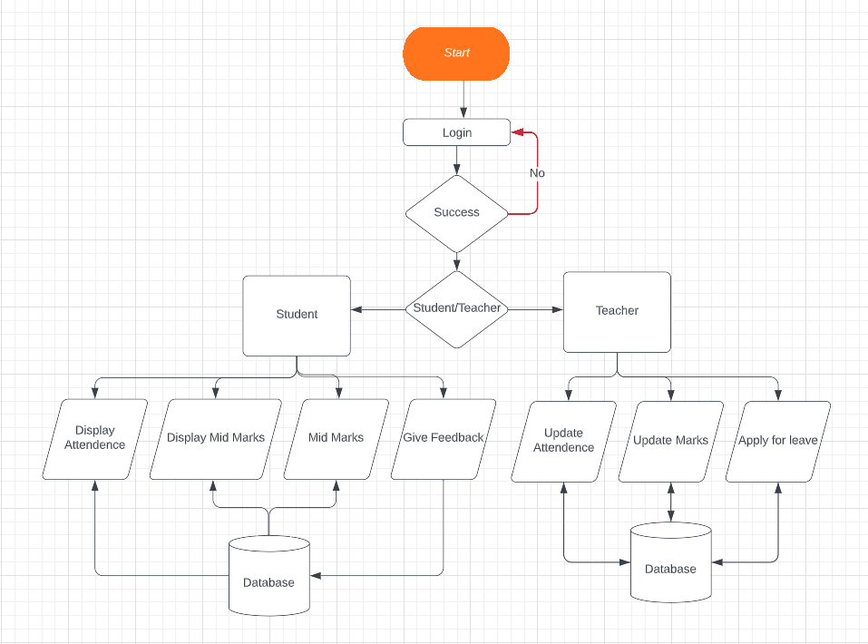
Work Flow

